Slide 1
2021 Point in Time & Housing Inventory Count
Missouri Statewide

Slide 2
What is HIC?
Housing Inventory Count (HIC)
Point-in-time inventory of providers within a Continuum of Care that provide beds and units dedicated to persons who are homeless.
HIC data is collected for a single night at the end of January.
The following project types are included:
Emergency Shelter (ES)
Transitional Housing (TH)
Safe Haven (SH)
Rapid Rehousing (RRH)
Other Permanent Housing (OPH)
Permanent Supportive Housing (PSH)

Slide 3
2021 HIC Snapshot
BED COUNT BY PROJECT TYPE
BED COUNT BY COC
14,690
Total Beds
12,205
BED COUNT BY HOUSEHOLD TYPE
Total PIT Count

Slide 4
Increase Utilization
From 2020 to 2021,
Missouri has
not changed
utilization rate
at 83%
ES, SH decreased
OPH, PSH increased

Slide 5
Increase RRH Beds
From 2020 to 2021,
Missouri has
increased
RRH beds
by 56%

Slide 6
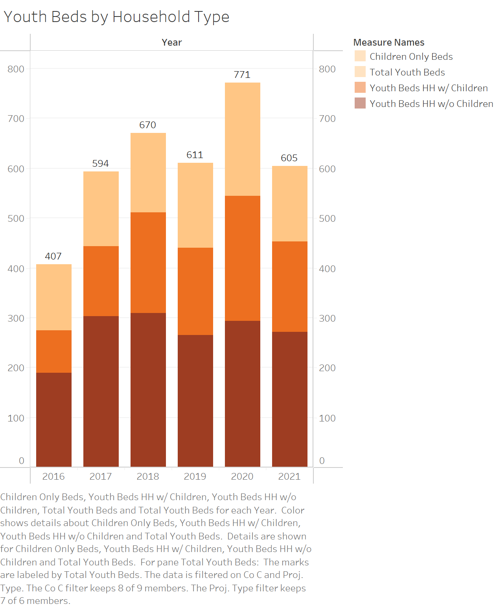
Increase Youth Beds
From 2020 to 2021,
Missouri has
decreased
youth beds
by 22%

Slide 7
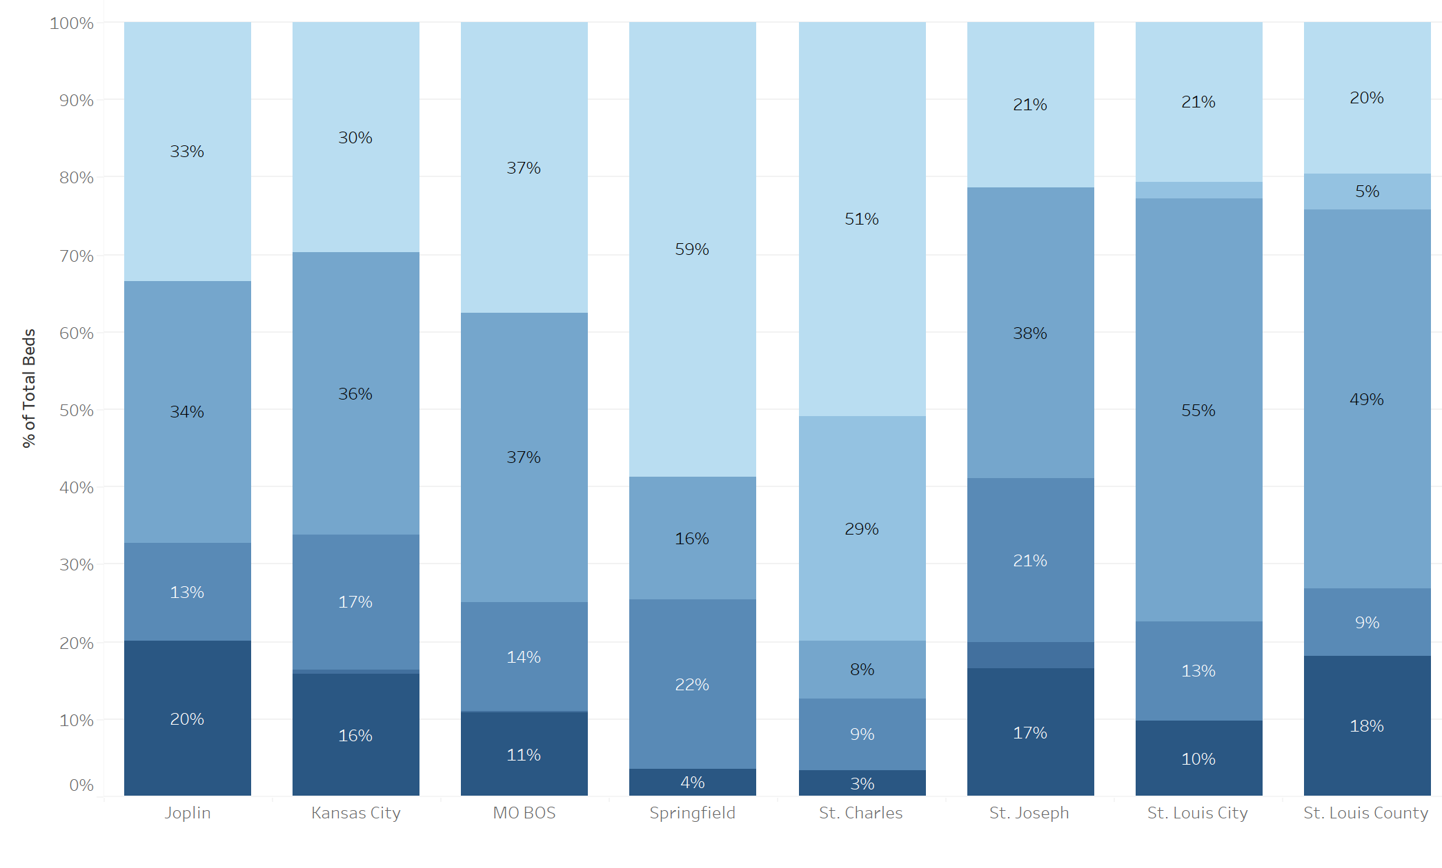
2021 CoC Comparison

Slide 8
What is PIT?
Point In Time (PIT) Count
Counts and collects demographic information on sheltered and unsheltered persons experiencing homelessness
Conducted on a single night at the end of January
Sheltered Count
Emergency Shelter (ES)
Safe Haven (SH)
Transitional Housing (TH)
Unsheltered (UN) count
Individuals staying on the streets, encampments, in their car, or other places not intended as housing
2021: Due to COVID-19, HUD allowed for flexibility on type and whether an unsheltered count would be conducted
Balance of State: no unsheltered count
St. Louis City & County: head count only

Slide 9
2021 PIT Snapshot
PERSONS BY PROJECT TYPE
4,926
Total Persons
PERSONS BY COC
4,079
Sheltered Persons
847
Unsheltered Persons

Slide 10
Reduce Sheltered Homelessness
From 2020 to 2021,
Missouri has decreased
sheltered homelessness
by 17%

Slide 11
Reduce Unsheltered Homelessness
From 2020 to 2021,
Missouri has decreased
unsheltered homelessness
by 48%**
**BoS did not complete 2021 Unsheltered count

Slide 12
Reduce Unsheltered Homelessness*
From 2020 to 2021,
CoCs other than BoS have decreased
unsheltered homelessness
by 15%

Slide 13
Reduce Family Homelessness
HUD 2019 NOFA
Reduce by 5%
From 2020 to 2021,
Missouri has
decreased
family homelessness
by 16%

Slide 14
Reduce Racial Disparity
According to the most recent (2019) American Community Survey data, Black or African Americans comprised 11.5% of the Missouri population.
In 2021, Black or African American individuals comprised 35% of the homeless population, down 3% from 38% in 2020.
https://data.census.gov/cedsci/profile?g=0400000US29

Slide 15
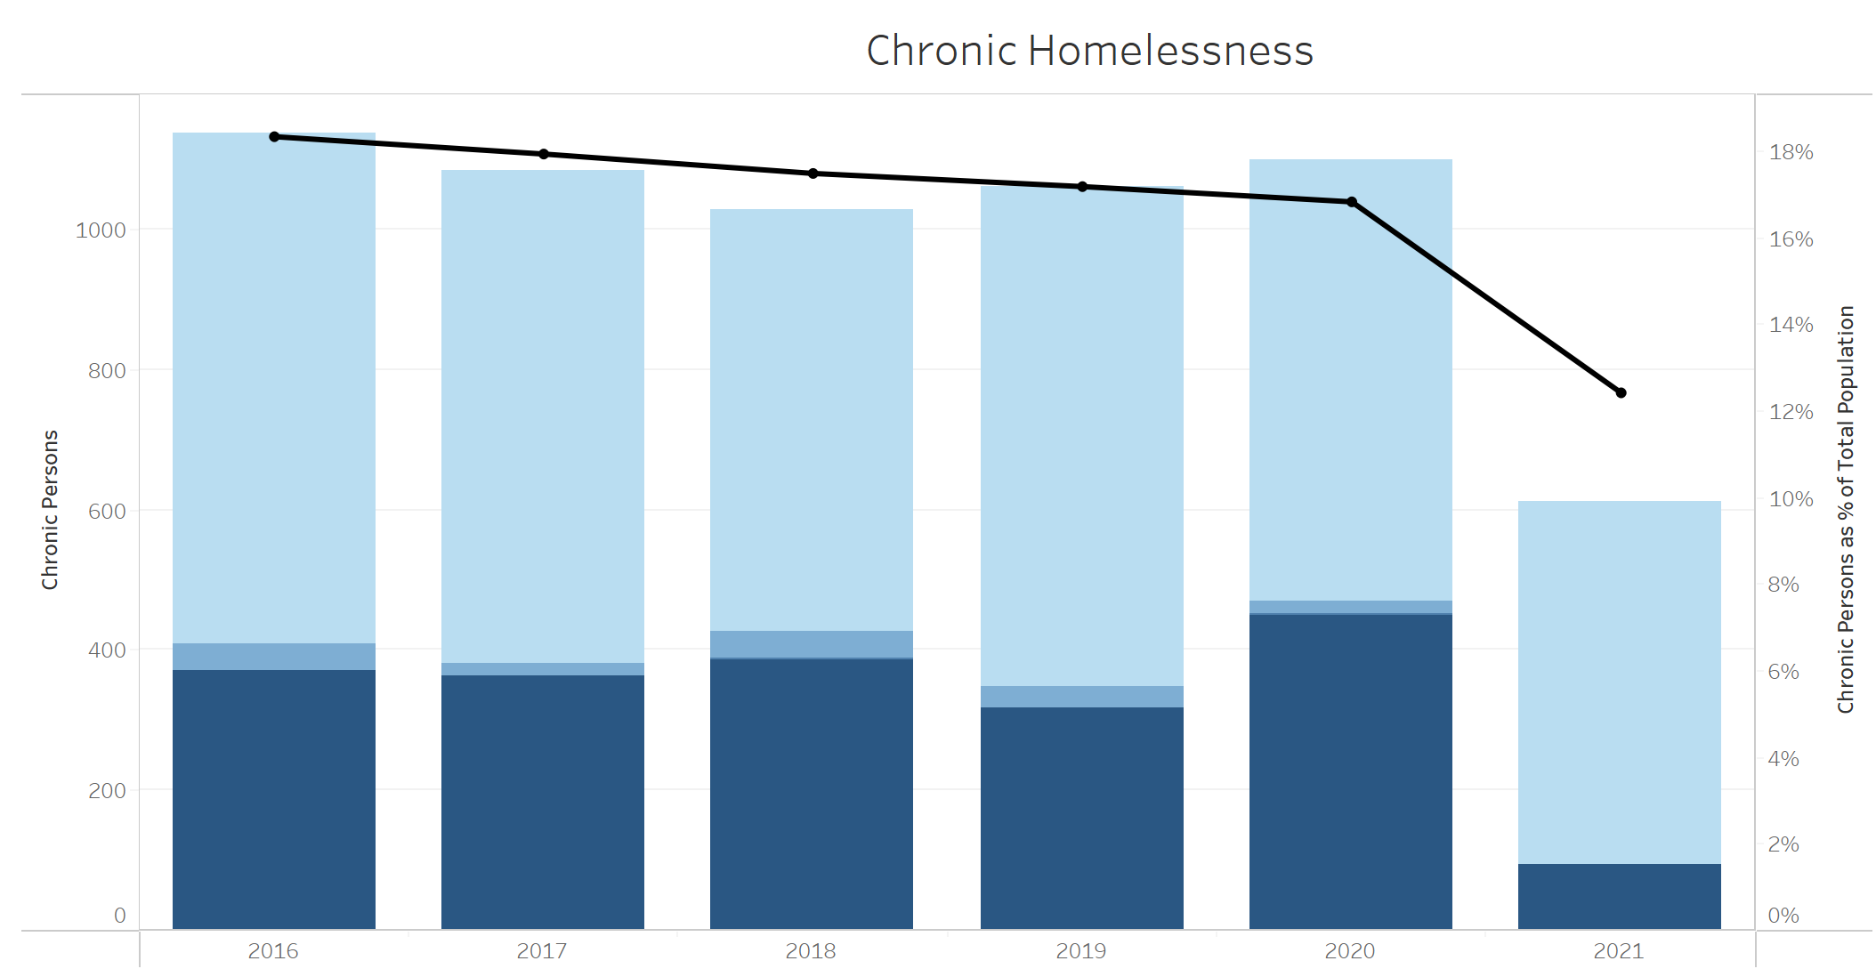
Reduce Chronic Homelessness
HUD 2019 NOFA
Reduce by 5%
From 2020 to 2021,
Missouri has
decreased
chronic homelessness
by 44%*

Slide 16
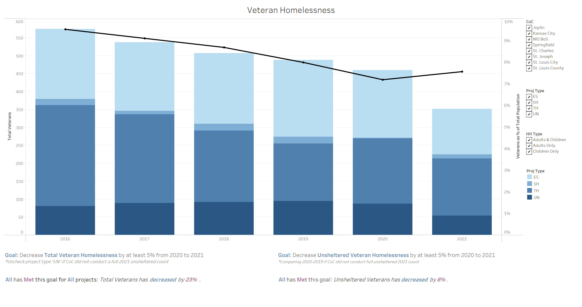
Reduce Veteran Homelessness
HUD 2019 NOFA
Reduce by 5%
From 2020 to 2021,
Missouri has
decreased
Veteran homelessness
by 23%*

Slide 17
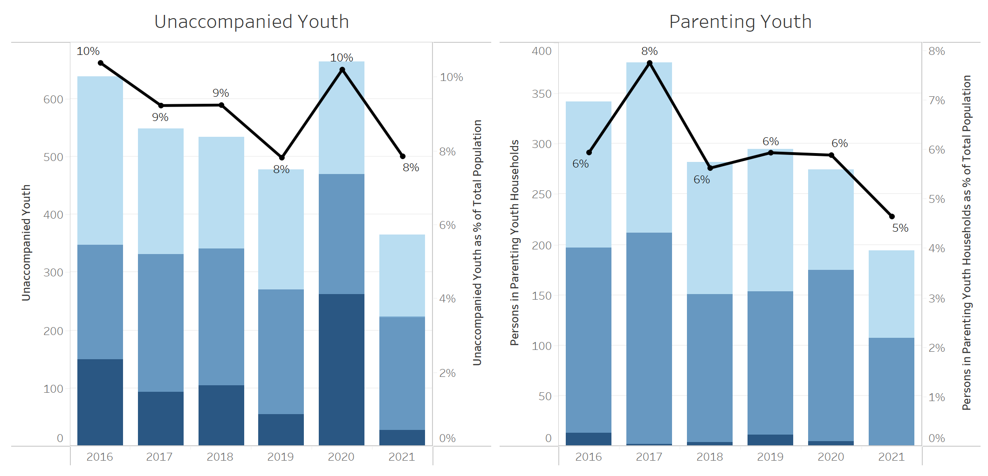
Reduce Youth Homelessness
From 2020 to 2021,
Missouri has
decreased
unaccompanied youth
homelessness by 45%
decreased
parenting youth
homelessness by 29%

Slide 18
2021 CoC Comparison

Slide 19
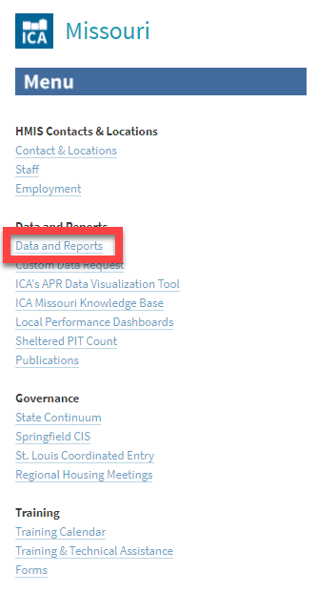
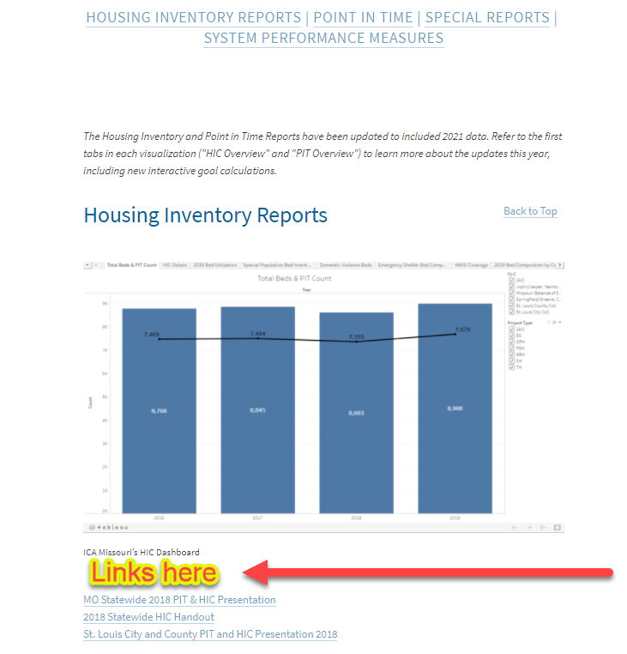
Thank you!
https://icalliances.org/missouri
Kaitlyn Poepsel, PhD
kaitlyn.poepsel@icalliances.org
Go to
https://icalliances.org/missouri
to find links to
PowerPoint presentation
underlying dashboards

