Slide 1
2022 Point in Time & Housing Inventory Count
Missouri Statewide
Kaitlyn Poepsel, PhD
6/30/22

Slide 2
What is HIC?
Housing Inventory Count (HIC)
Point-in-time inventory of providers within a Continuum of Care that provide beds and units dedicated to persons who are homeless.
HIC data is collected for a single night, typically at the end of January.
The following project types are included:
Emergency Shelter (ES)
Safe Haven (SH)
Transitional Housing (TH)
Rapid Rehousing (RRH)
Permanent Supportive Housing (PSH)
Other Permanent Housing (OPH)

Slide 3
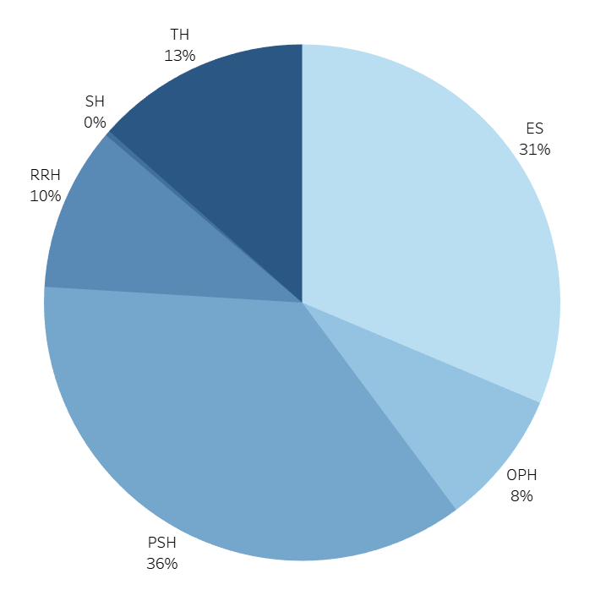
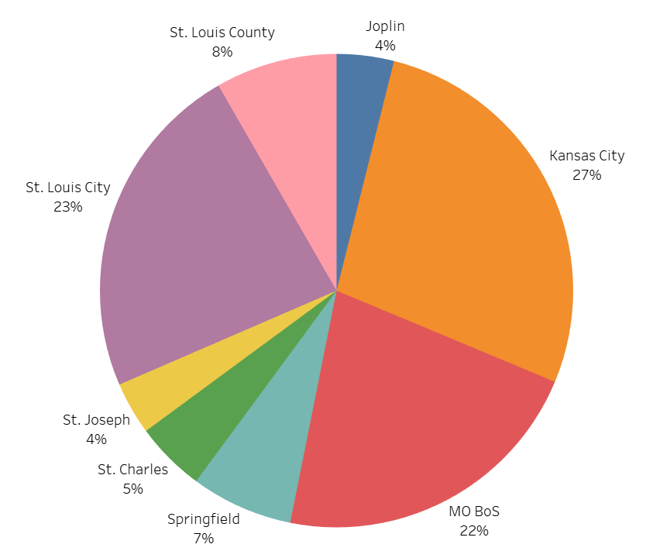
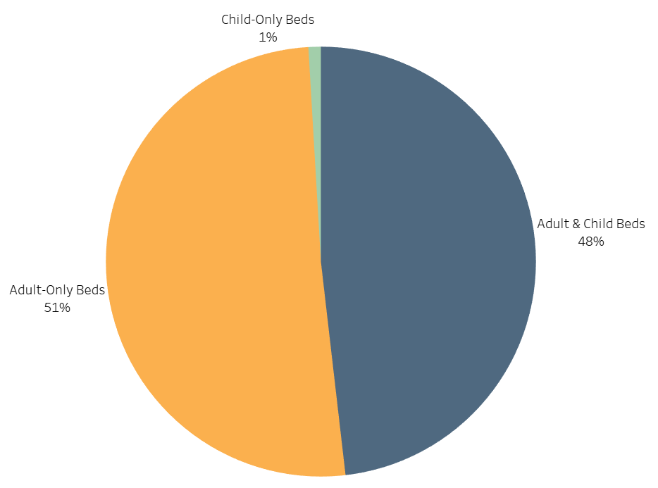
2022 HIC Snapshot
BED COUNT BY PROJECT TYPE
BED COUNT BY COC
15,758
Total Beds
12,467
BED COUNT BY HOUSEHOLD TYPE
Total PIT Count

Slide 4
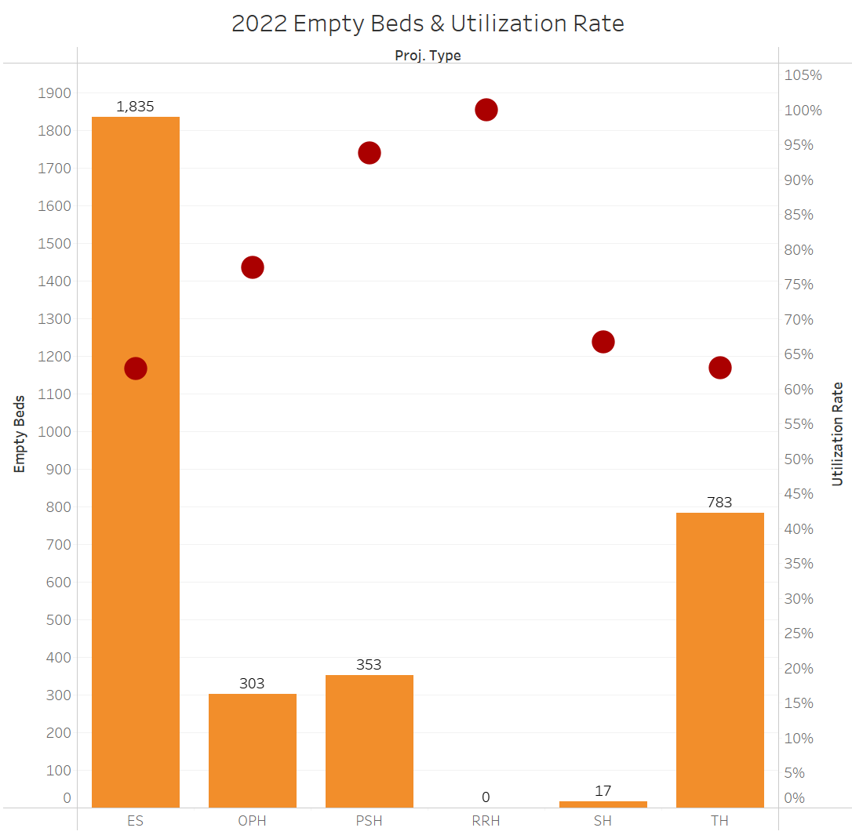
Increase Utilization
From 2021 to 2022,
Missouri has
decreased
utilization rate
by 5% to 79%

Slide 5
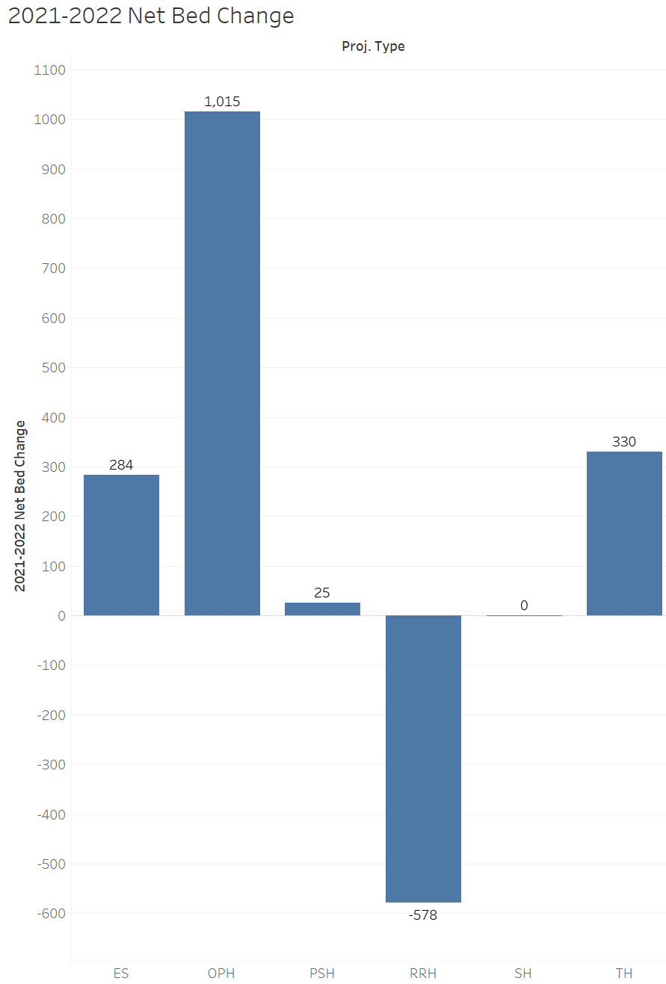
Increase RRH Beds
From 2021 to 2022,
Missouri has
decreased
RRH beds
by 26%

Slide 6
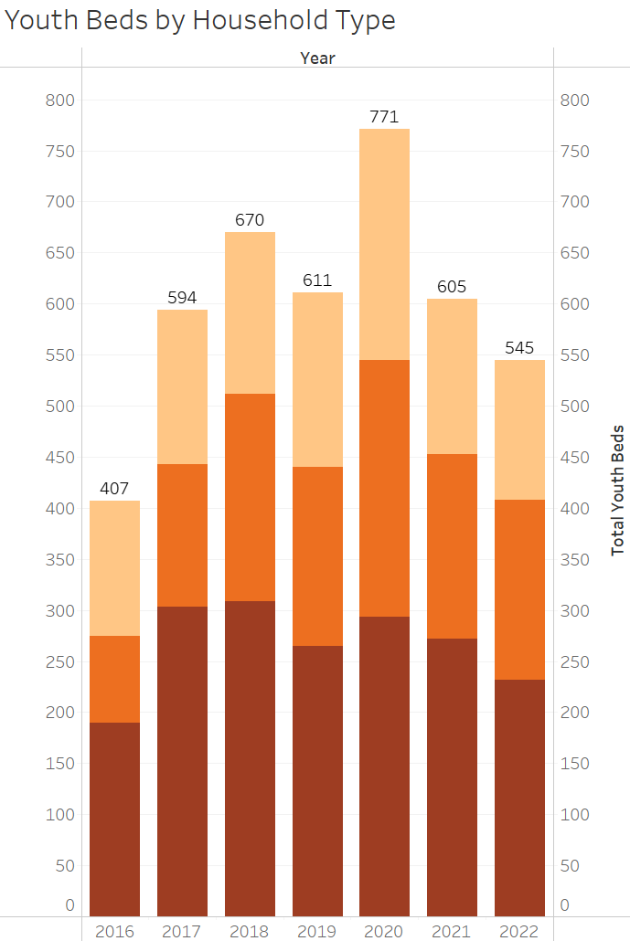
Increase Youth Beds
From 2021 to 2022,
Missouri has
decreased
youth beds
by 10%

Slide 7
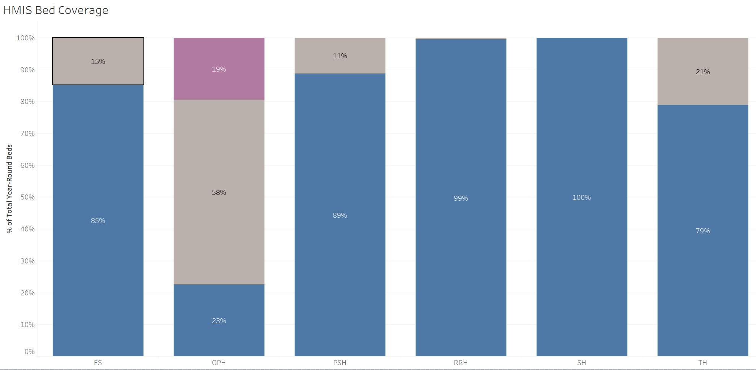
HMIS Bed Coverage
In 2022,
Missouri’s
HMIS bed coverage
was lower
than 85% at 81%

Slide 8
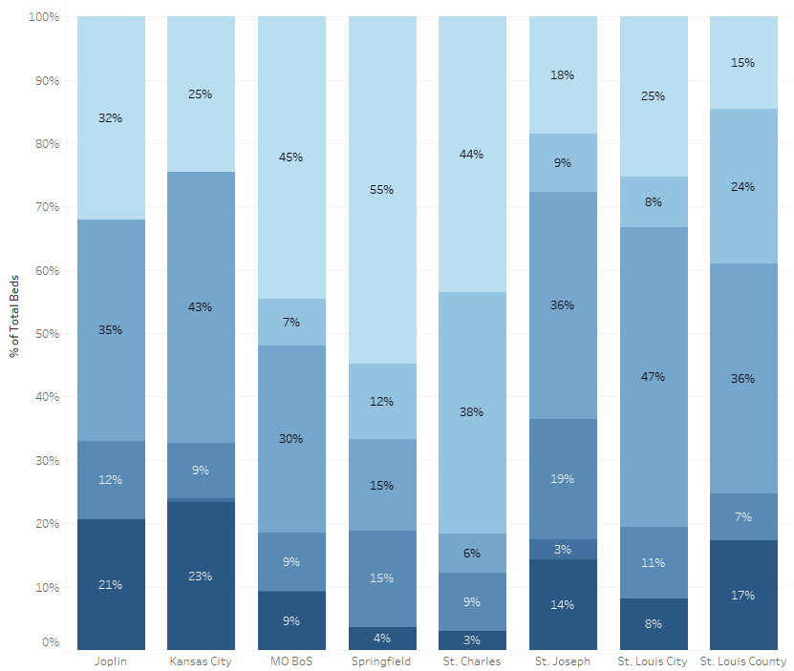
2022 CoC Comparison

Slide 9
What is PIT?
Point In Time (PIT) Count
Counts and collects demographic information on sheltered and unsheltered persons experiencing homelessness
Conducted on a single night, typically at the end of January
Sheltered Count
Emergency Shelter (ES)
Safe Havens (SH)
Transitional Housing (TH)
Unsheltered (UN) count
Individuals staying on the streets, encampments, in their car, or other places not intended as housing

Slide 10
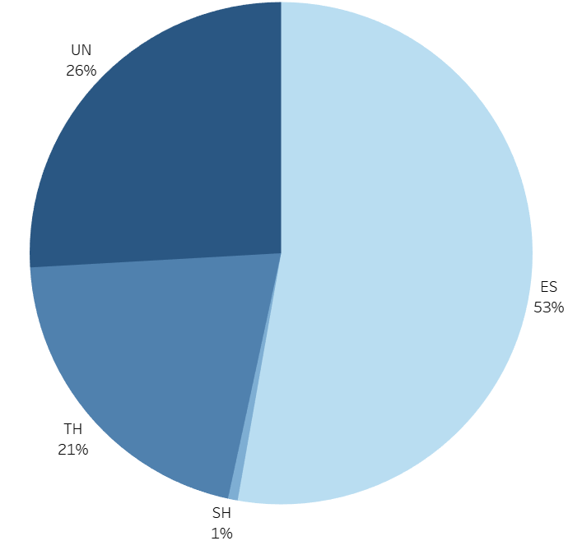
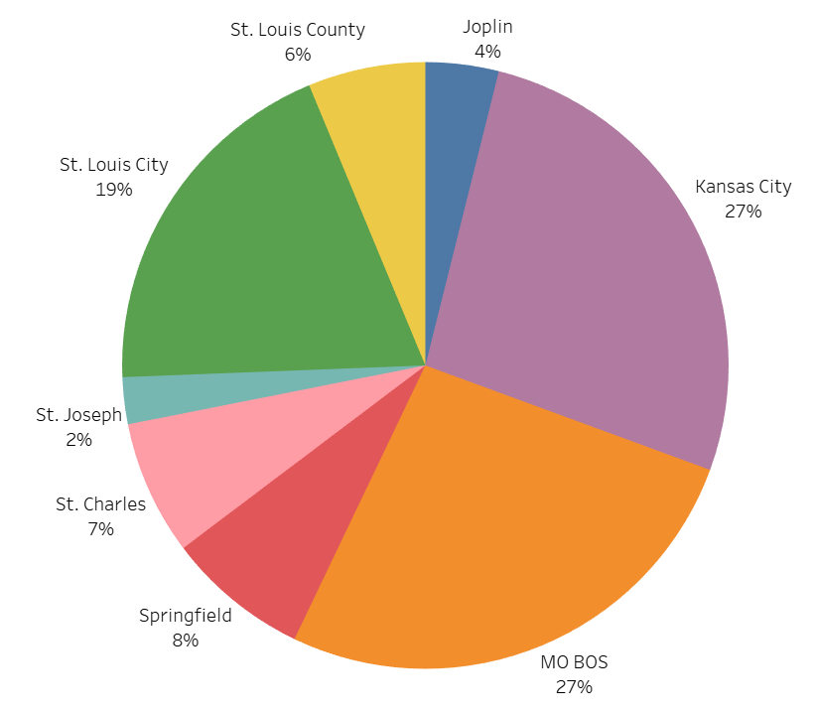
2022 PIT Snapshot
4,391
Sheltered Persons
5,926
1,535
Total Persons
Unsheltered Persons
PERSONS BY COC
PERSONS BY PROJECT TYPE

Slide 11
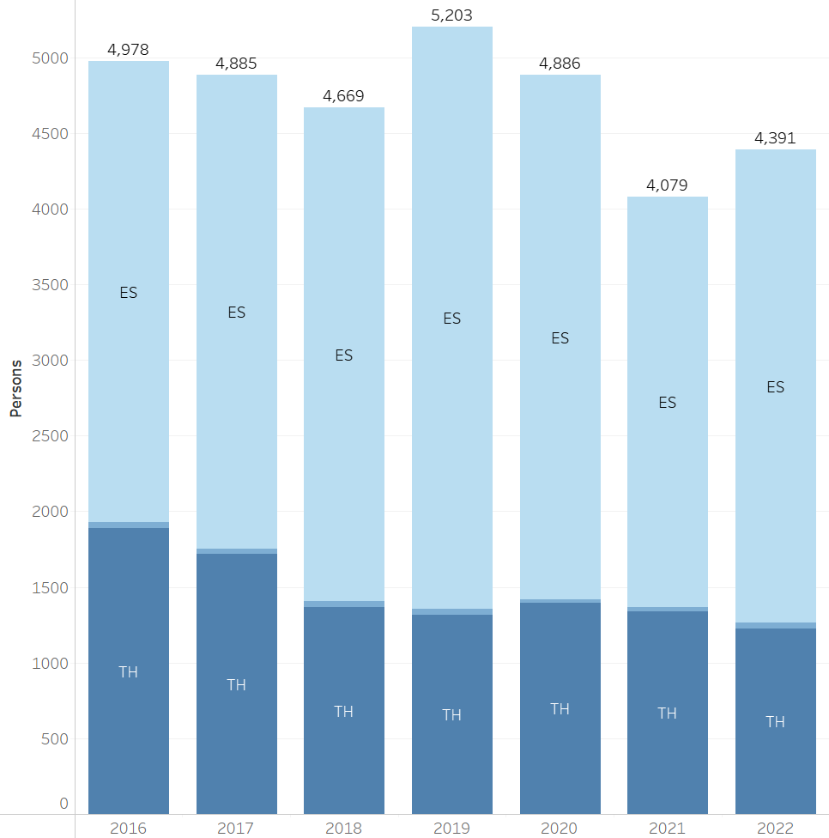
Reduce Sheltered Homelessness
From 2021 to 2022,
Missouri has
increased
sheltered homelessness
by 8%

Slide 12
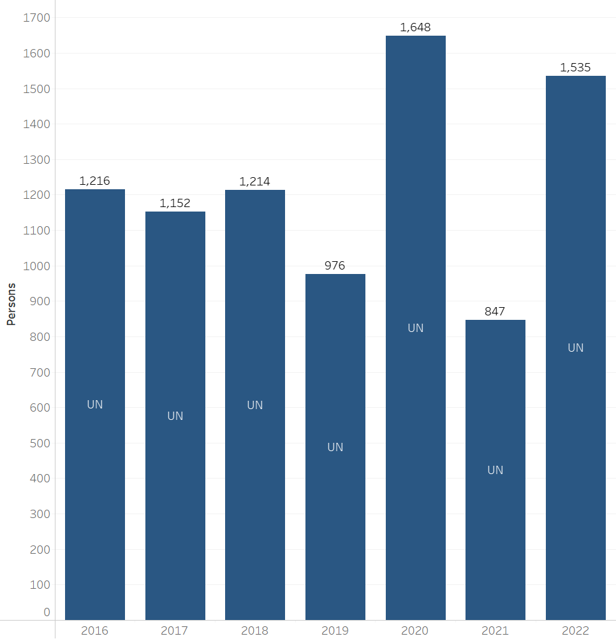
Reduce Unsheltered Homelessness
**
From 2021 to 2022,
Missouri has
decreased
unsheltered homelessness
by 7%

Slide 13
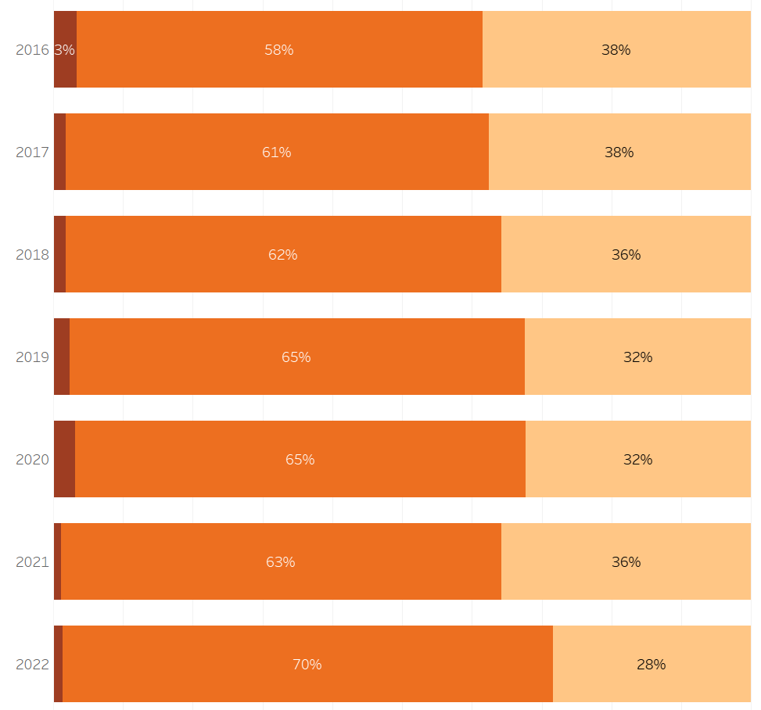
Reduce Family Homelessness
From 2021 to 2022,
Missouri has
decreased
family homelessness
by 5%

Slide 14
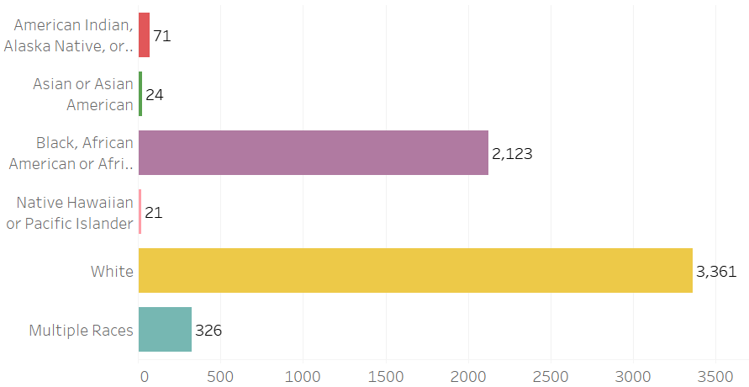
Reduce Racial Disparity
According to the 2020 Census, Black, African American, or Africans comprised 11.4% of the Missouri population.
In 2022, Black, African American, or Africans individuals comprised 36% of the homeless population, up 1% from 35% in 2021.
https://data.census.gov/cedsci/profile?g=0400000US29

Slide 15
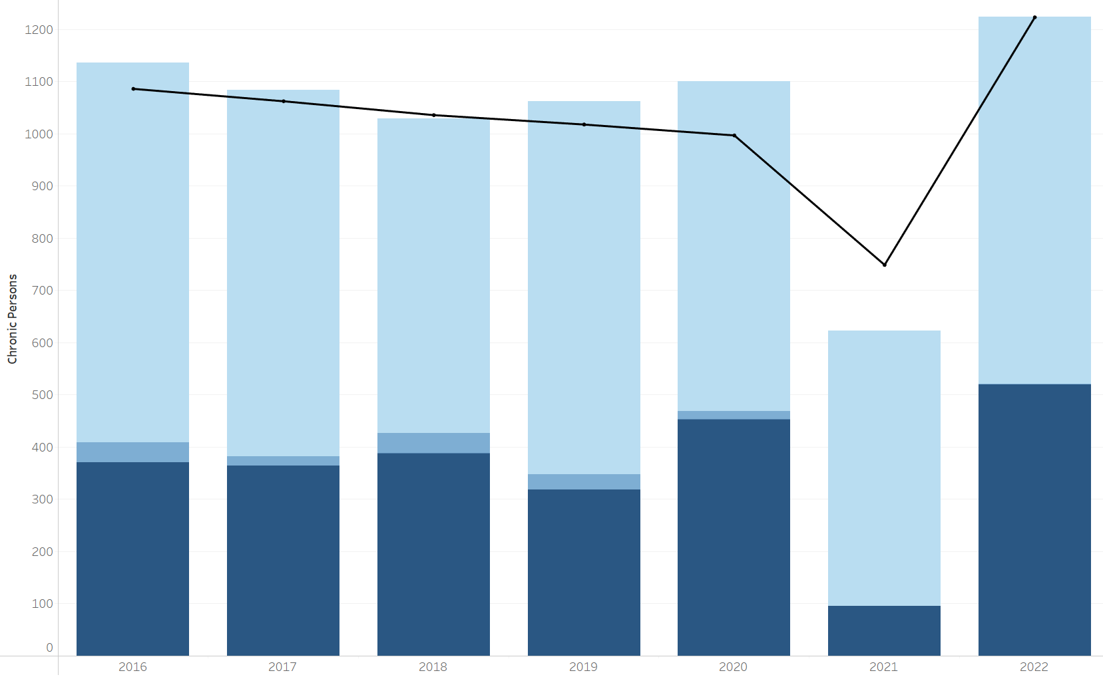
Reduce Chronic Homelessness
From 2021 to 2022,
Missouri has
increased
chronic homelessness
by 96%

Slide 16
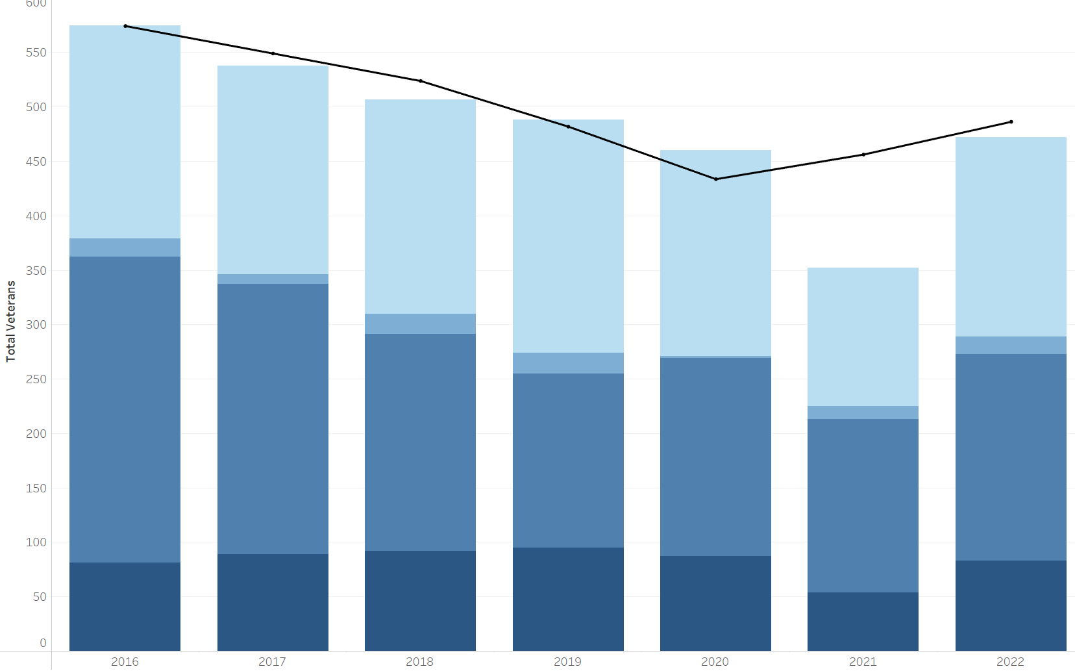
Reduce Veteran Homelessness
From 2021 to 2022,
Missouri has
increased
veteran homelessness
by 34%

Slide 17
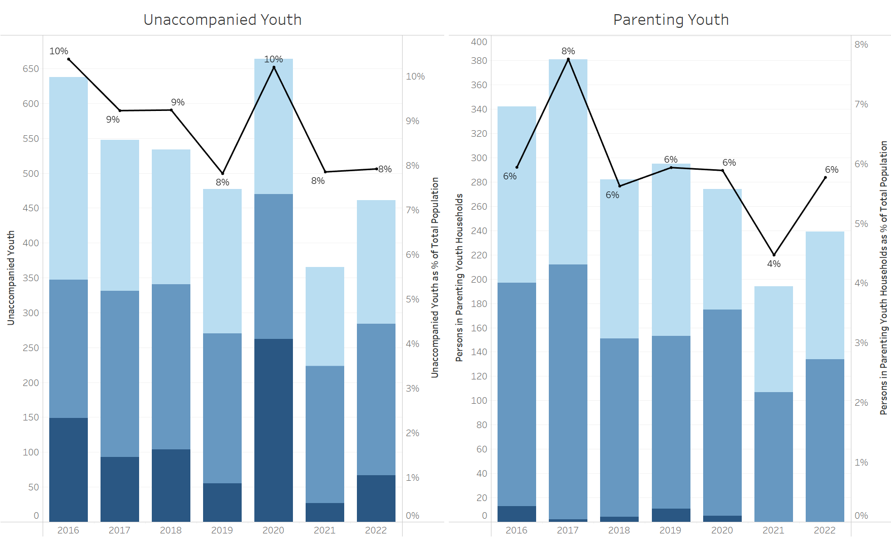
Reduce Youth Homelessness
From 2021 to 2022,
Missouri has
increased
unaccompanied youth
homelessness by 26%
increased
parenting youth
homelessness by 23%

Slide 18
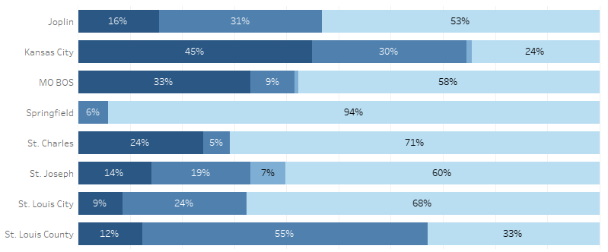
2022 CoC Comparison

Slide 19
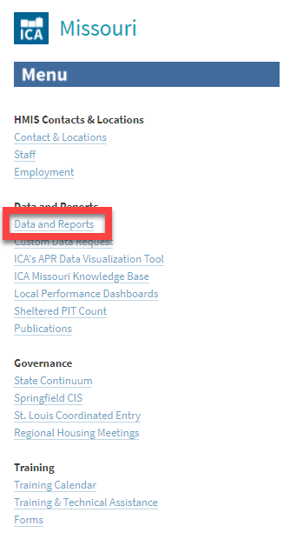
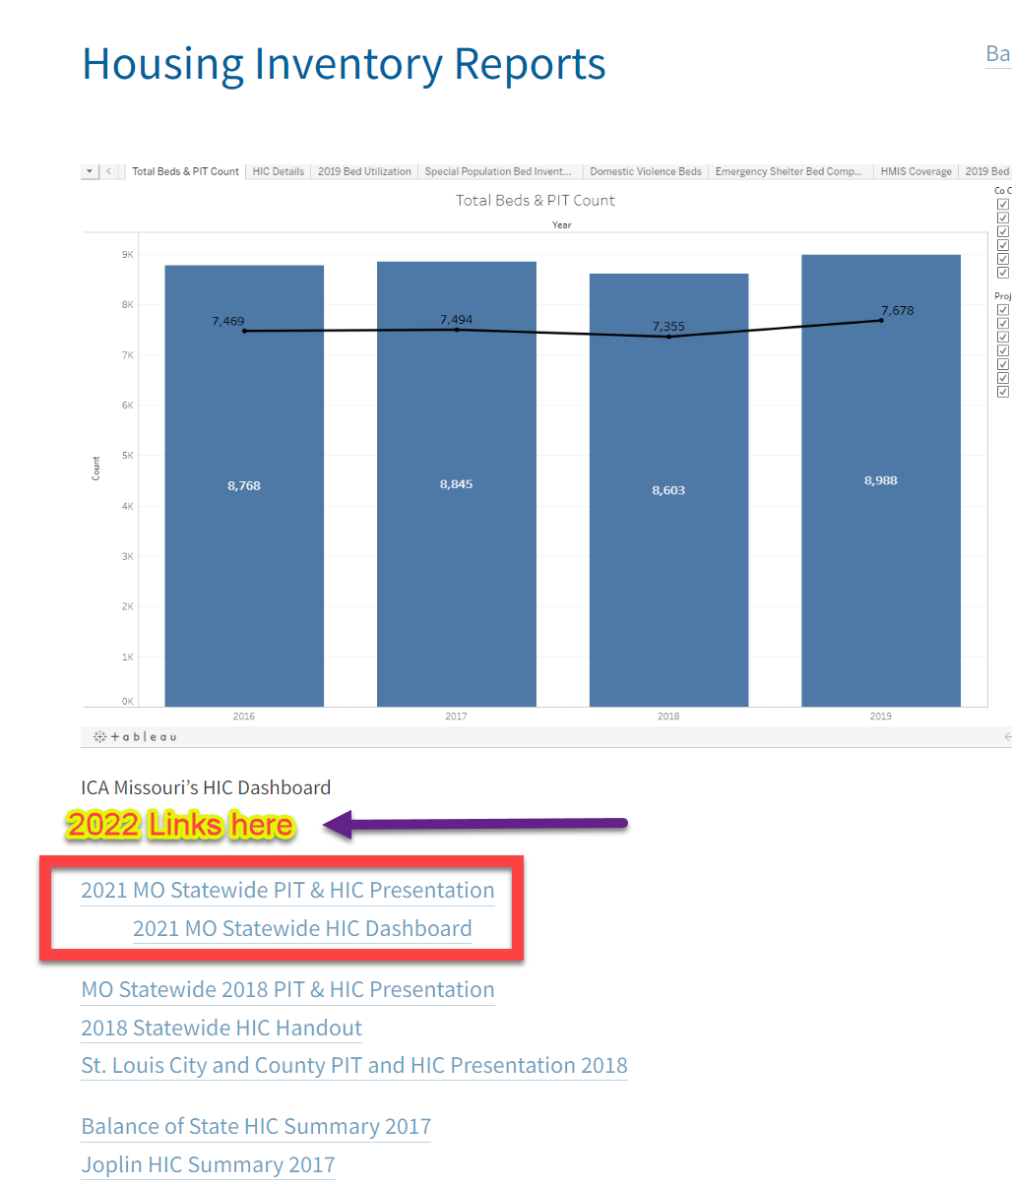
Thank you!
https://icalliances.org/missouri
Kaitlyn Poepsel, PhD
kaitlyn.poepsel@icalliances.org
Go to
https://icalliances.org/missouri
to find links to
PowerPoint presentation
underlying dashboards

